Slide 1
Zebrafish in the Classroom
Presented by: Cory Doroff and Amy Van Hecke

Slide 2
Introduction
Students may find it more useful to have examples in the lab handout so...
Objective
To introduce a dihybrid cross into the lab handout and work through the whole process of testing heritability
-Punnett Square analysis
-Chi-Square analysis

Slide 3
Improvements to Lab Handout
Explain how to calculate expected values
Step by step explanation of a dihybrid cross
Explain how notation is verbally communicated, along with the written annotation
Based on Laboratory 1 Worksheet. Biol 2202. 2013.

Slide 4
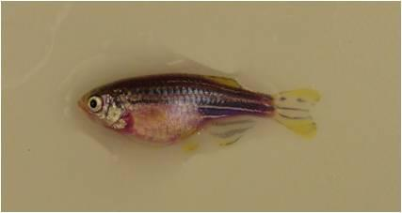
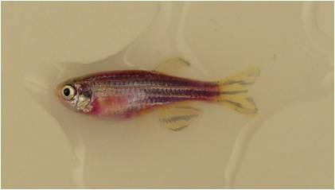
Methods
X
We started with documentation of the hemizygous parents
And then all 15 progeny
The genotypes we were working with were PFP (purple fluorescent protein) or wild-type and golden (gol) or not golden

Slide 5
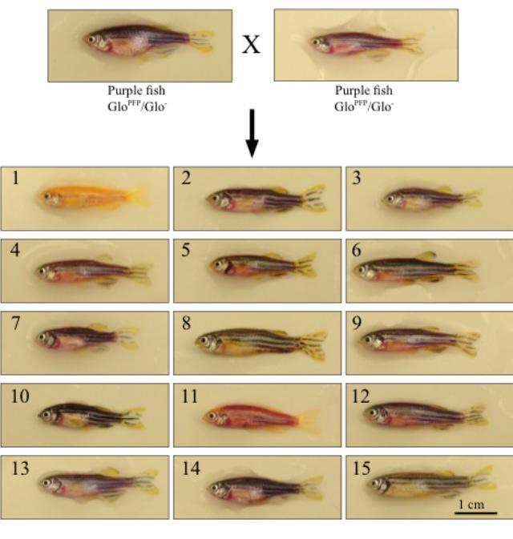
Cross Template
Dihybrid Cross Key
Phenotype | Fish ID#
Golden /wild-type (gray) | 1
Golden/purple | 11
Not golden/wild-type (gray) | 15, 10, 8
Not golden/purple | 2, 3, 4, 5, 6, 7, 9, 12, 13, 14
All fish photos, parents and progeny, were added to Dr. Liang's Template

Slide 6
Explanation of Annotation
We also wanted to add in an example annotation of the cross for other students to follow
Glo^{PFP} / Glo⁻ ; + / gol X Glo^{PFP} / Glo⁻ ; + / gol
Glo^{PFP}/Glo⁻ = hemizygous at the PFP allele
+/gol = hemizygous at the golden allele

Slide 7
Punnett Squares
 | Glo^{PFP} | Glo⁻
Glo^{PFP} | Glo^{PFP}/Glo^{PFP} | Glo^{PFP}/Glo⁻
Glo⁻ | Glo^{PFP}/Glo⁻ | Glo⁻/Glo⁻
 | + | gol
+ | +/+ | +/gol
gol | +/gol | gol/gol
Since purple is dominant over wild-type:
¾ purple
¼ not purple
Since golden is recessive to wild-type:
¾ not golden
¼ golden

Slide 8
How to Calculate Expected Values
List the phenotypes of progeny
Multiply the 2 fractions that relate to the specific phenotype
Multiply the result from #2 by the total number of progeny observed
Example: Purple with golden mutation
3/4 * 1/4 * 15 = 2.8 ---> 3.0

Slide 9
Table of Expected Values
Phenotype | Expected Number of GloFish
Purple/not golden | ¾ * ¾ *15 = 8.44 ---> 8
Wild-type/not golden | ¼ * ¾ * 15 = 2.8 ---> 3
Purple/golden | ¾ * ¼ * 15 = 2.8 ---> 3
Wild-type/golden | ¼ * ¼ * 15 = 0.93 --->1

Slide 10
Chi-Square Analysis
(1) | (2) | (3) | (4) | (5) | (6)
Phenotype | Observed | Expected | d=(o-e) | d² | d²/e
Purple/not golden | 10 | 8 | 2 | 4 | 0.5
Wild-type/not golden | 3 | 3 | 0 | 0 | 0
Purple/golden | 1 | 3 | -2 | 4 | 1.33
Wild-type/golden | 1 | 1 | 0 | 0 | 0
Total | 15 | 15 |  |  | 1.83
X² = 1.83
Degrees of freedom = 3
p-value = 0.65-0.7

Slide 11
Summary/Conclusion
Since the p-value was between 0.65 and 0.7, the hypothesis is supported and significant.
We think that these additions will be very useful to future students by
-helping the teacher with a fun and unusual example
-helping the students understand the concepts and notations of dihybrid crosses

Slide 12
Questions?

